Slide 1
How to setup your Mblock ?

Slide 2
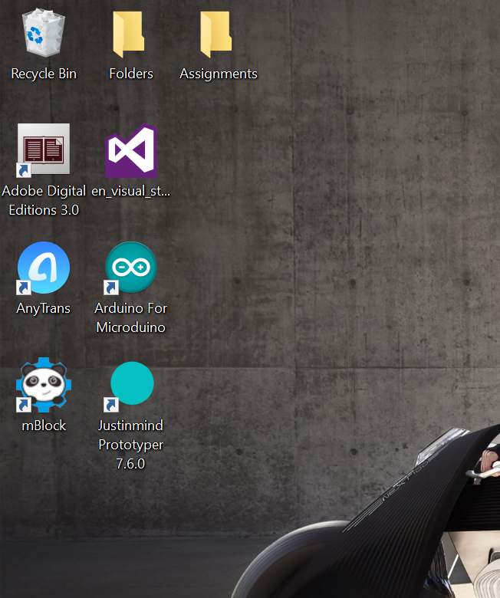
STEP 1. INSTALL MBLOCk
Launch your browser and goto the following link to download latest version of mBlock http://www.mblock.cc/
Download the software and install it
Now, a small panda icon should appear on your desktop, find it !

Slide 3
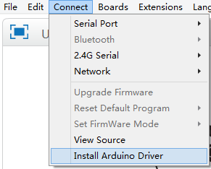
STEP 2. Install Arduino Driver
Now, go to Connect > Install Arduino Driver
For Mac users, download the driver. Unfortunately, the latest update for the Mac OSX introduced an issue with this driver
https://raw.githubusercontent.com/Makeblock-official/Makeblock-USB-Driver/master/CH34x_Install.zip

Slide 4
Step 3. Connect your mbot
Connect your robot to your computer via USB cable, turn your robot on, and open mBlock
Go to Connect-> Serial Port -> (port ID)
(TIP: If you don’t know the port ID you are connected to, make a note of the available ports, disconnect your robot, and see which port disappears.)

Slide 5
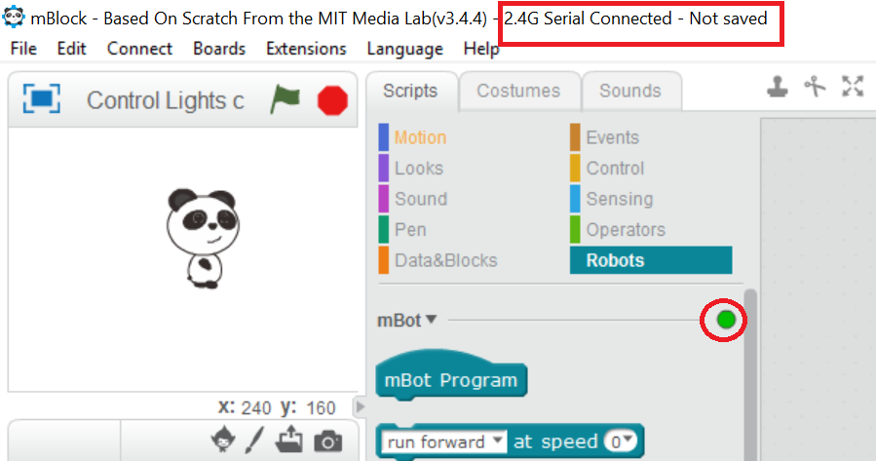
Step 3. Connect your mbot (continue)
Once you have successfully connected, the title bar will say you are connected and the red dot in the “Robots” Scripts will turn green
NOTE: To upgrade firmware, to reset the default program and to upload a program onto the robot board, you MUST be connected via USB

Slide 6
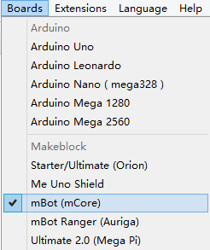
Step 3. Connect your mbot (continue)
Next, make sure you have the appropriate board selected in the Board menu:
Starter / Ultimate – Orion
mBot – mCore
mBot Ranger – Auriga
Ultimate 2.0 – Mega Pi
Here, I am using mBot, so the mCore board is selected
That’s it ! Now, enjoy programming your mBot !!

